Slide 1
RAN Architectures

Slide 2
RAN Architecture
Strategic Plan & Scope
High Level Network Architecture
Strategic Considerations
Financial Constraints
Spectrum Regulation and Allocation
Equipment Supplier & MNO Agreements
Network Design
RAN Architecture
TX Network Architecture
Network
Monitoring Architecture
Mobile Core Architecture
Network Design
Deployment
Operations & Maintenance
Field Maintenance
Post-Launch Engineering
Supply Chain Management

Slide 3
RAN Architecture
Inputs
RF Specifications
Strategic Rules
Business Case
Gov. & Social Regulations
Coverage Targets &
Service Penetration
Existing Equipment & Infrastructure
Geodemographic Data
Spectrum
FDD/TDD
Tx Power
RAN Topology & Scenario Definition
Reference RAN Architecture
Engineering Guidelines
Equipment Requirements
D-RAN / C-RAN
Greenfield / Overlay Scenarios
Demarcation Point
Macro / Small Cell Scenarios
Functional Requirements
RAN Sharing
VoLTE
Equipment Requirements
Engineering Guidelines
Coverage & Capacity
Infrastructure

Slide 4
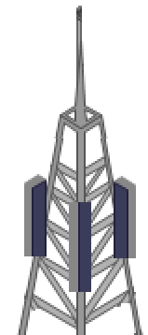
RAN Architecture
RAN
Transport Network
Mobile Core
(EPC)

Slide 5

RAN Architecture
RRU
+
Antennas
BBU
Transport Network

Slide 6

RAN Architecture
RRU
+
Antennas
Fronthaul Network
Transport Network

Slide 7
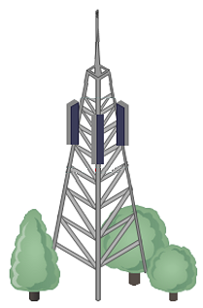
RAN Architecture
Macro Cell Height:
Up to 40m
Small Cell Height:
Up to 10m
Small Cell Coverage: ~ 2-5km
Macro Cell Coverage: ~5-10km

Slide 8
RAN Architecture
Capacity Bands
Coverage Bands
Cell Radius
High Frequencies (> 1 GHz)
Low Frequencies (< 1 GHz)
Urban
Sub-urban
Rural

Slide 9
RAN Architecture
Guardband
Frequency
GSM
LTE
GSM

Slide 10

RAN Architecture
FDD Scheme
TDD Scheme
Frequency
Frequency
Uplink
Downlink
Downlink
Uplink
Time
Time Slot
Time

Slide 11
RAN Architecture
RAN
Mobile Core
MNO 1
Virtual Gateway
Mobile Core
MNO 2
O&M
NaaS Operator Control

Slide 12
RAN Architecture
RAN
IPsec Tunnel
IPsec Tunnel
Mobile Core
MNO 1
IPsec Gateway
IPsec Gateway
Mobile Core
MNO 2
O&M
NaaS Operator Control

Slide 13
RAN Architecture
MORAN
MOCN
Roaming
MNO1 Core
MNO2 Core
MNO1 Core
MNO2 Core
NaaS Operator Core
MNO1 Core
Spectrum MNO1
Spectrum MNO2
Spectrum Pool
NaaS Operator Spectrum
NaaS Operator
Operational Scope

Slide 14
RAN Architecture
GSM/UMTS RAN
Circuit Switched Core
CS Fall Back
LTE RAN
Evolved Packet Core (4G core network)

